Slide 1

OPTIMIZED CHAOTIC MAP-BASED TECHNIQUES FOR EFFICIENT AND SECURE REAL-TIME IMAGE ENCRYPTION.
Presented by: Under the guidance of:
R. Selvanayaki Dr. R. Sujarani
225058039 Asst. professor
II Msc. Computer Science Department of CSE

Slide 2
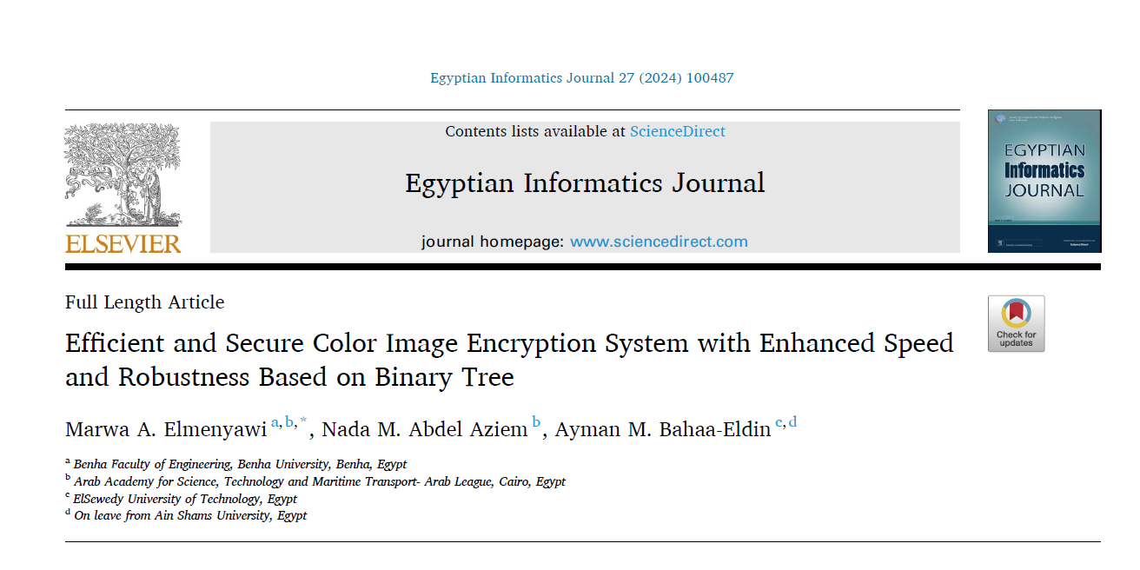
BASE PAPER

Slide 3
ABSTRACT
This project presents a color image encryption system combining Radial Basis Function (RBF) for confusion and a Logistic Chaotic Map for diffusion to enhance security and efficiency.
A secure key generation process integrates user input and image characteristics, reinforcing encryption strength.
The RBF scrambles pixel positions non-linearly based on kernel transformations, ensuring high unpredictability.
The Logistic Chaotic Map modifies pixel intensities using chaotic sequences for robust diffusion.
The proposed method achieves high randomness, low correlation, and resilience against cryptographic attacks.

Slide 4
PROBLEM STATEMENT
As digital communication, cloud storage, and online transactions become increasingly prevalent, securing image data has become a critical concern. These methods often fail to provide the level of randomness needed to protect sensitive image data from unauthorized access, tampering, or cyber threats.
Additionally, many encryption techniques are computationally inefficient, which makes them unsuitable for real-time applications.
Key management also plays a crucial role, as weak or predictable keys can easily be exploited to decrypt sensitive data. Therefore, there is a pressing need for a new encryption approach that addresses these challenges. The ideal system should offer high randomness, minimal pixel correlation, and robust resistance to attacks while maintaining computational efficiency for real-time use.
Developing a secure and efficient image encryption technique will be essential for protecting digital images in fields where data confidentiality, integrity, and authenticity are paramount.

Slide 5
LITERATURE REVIEW
Title | Authors name | Journal name | Techniques used | Inference | Year- Volume
An efficient algorithm to generate dynamic substitution-boxes and its applications in image encryption | MuhammadBilala, Ghulam Murtazab, Bilal Demirc, Miguel D. Bustamanted, Umar Hayata | Alexandria Engineering Journal | Elliptic Curves (EC) Mobius Transformations | Combines Elliptic Curves and Mobius Transformations for S-box generation. Produces S-boxes with high security against various attacks. Not all parameter combinations generate valid S-boxes. | 2025 & 115
Optimal Algorithm for Color Medical Encryption and Compression Images Based on DNA Coding and a Hyperchaotic System in the Moments | Ahmed Bencherqui, Mohamed Amine Tahiri, Hicham Karmouni. | Engineering Science and Technology, an International Journal | Discrete orthogonal Hahn moments (HMs) Archimedes optimization algorithm (AO) Hyperchaotic memristive 4-D system (HCM-4D) | The proposed system achieved high compression ratios and maintained high-quality reconstructed images, with peak signal-to-noise ratio (PSNR) values exceeding 80 dB. | 2024 & 50
Title

Slide 6
LITERATURE REVIEW
Title | Authors name | Journal name | Techniques used | Inference | Year- Volume
Visually Meaningful Image Encryption for Secure and Authenticated Data Transmission Using Chaotic Maps | Deep Singh, Sandeep Kumar, Chaman Verma, Zoltán Illés, Neerendra Kumar | Journal of King Saud University - Computer and Information Sciences | RSA Cryptosystem Modified Hénon Map (MHM) Zigzag Confusion 3D Arnold Cat Map Secure Hash Algorithm (SHA-256) | The proposed VMIE scheme achieves high security, efficiency, and robustness by integrating encryption, digital signature, and steganography. | 2024 & 36
Dynamically scattering medium-based security-enhanced optical image encryption using orbital angular momentum and deep learning | Junbao Hu, Xutao Mo, Yu Lei, Xianshan Huang, Dong Wang | Results in Physics | Orbital Angular Momentum (OAM Dynamic Diffuser Convolutional Neural Network (CNN) | The study demonstrated that the combined use of dynamically scattering media, OAMs, and pre-trained CNNs significantly enhances the security of optical image encryption systems. | 2024 & 69
Title

Slide 7
LITERATURE REVIEW
Title | Authors name | Journal name | Techniques used | Inference | Year- Volume
A Low-Time-Consumption Image Encryption Combining 2D Parametric Pascal Matrix Chaotic System and Elementary Operation | Jun Lu, Jiaxin Zhang, Dezhi An, Dawei Hao, Xiaokai Ren, Ruoyu Zhao | Journal of King Saud University - Computer and Information Sciences | 2D Parametric Pascal Matrix Chaotic System (2D-PPMCS) SHA-256 hash values chaotic sequences and diffusion encryption | The proposed algorithm (LTC-IE) strikes a balance between encryption security and computational efficiency. Security experiments confirmed robustness, resistance to differential attacks, and improved randomization through entropy analysis. | 2024 & 36
Color Image Encryption Algorithm Using Rubik’s Cube Scrambling with Bitmap Shuffling and Frame Rotation | Aditi Nair, Diti Dalal, Ramchandra Mangrulkar | Cyber Security and Applications | Rubik’s cube scrambling Bitplane shuffling and frame rotation for encryption. Symmetric-key encryption methodology with two 128-bit keys. | Demonstrated efficiency in encrypting multimedia data with high practical applicability. Algorithm showed robustness in analytical and performance tests. | 2024 & 2
Title

Slide 8
LITERATURE REVIEW
Title | Authors name | Journal name | Techniques used | Inference | Year- Volume
Security of End-to-End Medical Image Encryption System Using Trained Deep Learning Encryption and Decryption Network | Saba Inam, Shamsa Kanwal, Anousha Anwar, Noor Fatima Mirza, Hessa Alfraihi | Egyptian Informatics Journal | Cycle-GAN (Cycle-Consistent Generative Adversarial Network) Binary Cross-Entropy Loss | The proposed deep learning-based encryption and decryption system ensures high security for medical images. Key performance highlights include: High PSNR value (39.98) indicating minimal distortion. | 2024 & 28
Chaotic Color Multi-Image Compression-Encryption/LSB Data Type Steganography Scheme for NFT Transaction Security | Zheyi Zhang, Yinghong Cao, Hadi Jahanshahi, Jun Mou | Journal of King Saud University - Computer and Information Sciences | Compression sensing (CS) for image compression. Chaotic hyper-discrete map Multi-cover LSB steganography | Enhanced security for NFT image transactions with improved compatibility for color images. Demonstrated strong resistance to statistical and differential attacks. | 2023 & 35
Title

Slide 9
LITERATURE REVIEW
Title | Authors name | Journal name | Techniques used | Inference | Year- Volume
Color Stereo Image Encryption and Local Zero-Watermarking Schemes Using Octonion Hahn Moments and Modified Henon Map | Achraf Daoui, Mohamed Yamni, Hicham Karmouni, Mhamed Sayyouri | Journal of King Saud University – Computer and Information Sciences | Octonion Hahn Moments (OHMs) 2D Henon map local zero-watermarking scheme | The encryption scheme achieved robust security against various attacks (statistical, noise, cropping). Zero-watermarking proved effective against geometric distortions, ensuring | 2022 & 34
A Randomized CPA-Secure Asymmetric-Key Chaotic Color Image Encryption Scheme | Ali Shakiba | Journal of King Saud University – Computer and Information Sciences | Chebyshev mappings for key generation. Chaotic sequences and one-time pad | Secure against chosen plaintext attacks (CPA) due to randomized design. High robustness against noise, data loss, and differential attacks. | 2021 & 33
Title

Slide 10
EXISTING SYSTEM
The encryption process outlined in the existing project consists of three main phases:
Key Generation
A unique encryption key is created by combining user input with the original image. XOR operations, summations, and SHA-256/384 hashing are applied to enhance security and minimize computational overhead.
Confusion Phase
The image is split into blocks and reorganized using a Binary Tree (BT) structure, ensuring non-adjacent same-color pixels. Inorder traversal generates a scrambled matrix, adding complexity to prevent cryptanalysis.
Diffusion Phase
The pixel values are modified using DNA sequence encoding and chaotic maps (Duffing and Tent maps). These operations dynamically determine the scrambling rules, ensuring unpredictability and robustness against attacks.
01
02
03

Slide 11
PROPOSED SYSTEM
This process outlines a comprehensive method for color image encryption with advanced cryptographic techniques. Here’s a breakdown of each phase with key points:
01
Key Generation Phase
SHA-256 Hashing: Hashing algorithms are used to derive strong, unpredictable encryption keys. SHA-256 ensures an initial layer of complexity.
Initialization: The generated key is then used to initialize the Radial Basis Function (RBF) and the 2D Logistic Map (LM), which will generate the key series utilized for the confusion and diffusion phases.

Slide 12
PROPOSED SYSTEM
This process outlines a comprehensive method for color image encryption with advanced cryptographic techniques. Here’s a breakdown of each phase with key points:
02
Confusion Phase
Image Block Division: The image is divided into manageable blocks, typically 8x8 or 16x16 pixels. This allows for localized manipulation of pixel arrangements.RBF Pixel.
Rearrangement: The Radial Basis Function, which uses a set of functions for interpolation, is employed to rearrange pixels within each block. The goal is to ensure that the output is significantly different from the input, increasing the encryption strength.
Non-Adjacent Pixel Swap: To increase randomness, pixels from the same color channel are not swapped adjacently. This enhances the security by ensuring that no predictable patterns are left in the color distribution.

Slide 13
PROPOSED SYSTEM
This process outlines a comprehensive method for color image encryption with advanced cryptographic techniques. Here’s a breakdown of each phase with key points:
03
Diffusion Phase
2D Logistic Map (LM): A chaotic system is used to generate pseudorandom sequences based on the initialized key. These sequences are vital for altering the pixel values unpredictably.
DNA Encoding & Operations: The pixel intensities are modified using DNA encoding techniques. XOR operations, addition, and other cryptographic operations are used on the pixel values to ensure that the encryption process is both robust and irreversible.
DNA Decoding: After performing the cryptographic operations, the DNA sequence is decoded to reveal the encrypted image.

Slide 14
PROPOSED SYSTEM
This process outlines a comprehensive method for color image encryption with advanced cryptographic techniques. Here’s a breakdown of each phase with key points:
04
Testing and Validation
Statistical Analysis: Various tests, such as entropy, NPCR (Number of Pixels Change Rate), UACI (Unified Average Changing Intensity), and correlation tests, are performed to measure the randomness, robustness, and security of the encrypted image.
Performance Metrics: The encryption time is recorded, and the system’s robustness against different attacks (e.g., differential, brute-force) is evaluated.

Slide 15
SYSTEM PLANNING
Color Image Encryption Process
Key Generation
Phase
Input
combination
SHA 256
Hashing
Initialization
RBF & 2D LM
setup
Confusion
Phase
Image Block
Division
RBF Pixel
Rearrangement
Non-Adjacent
Pixel Swap
Diffusion
phase
DNA encoding &
encryption
Logistic Map
Testing and
Validation
Statistical
Analysis
Performance
Metrics

Slide 16
REQUIREMENTS
Hardware Specifications :
Processor : Intel(R) Core(TM) i5-6300U CPU @ 2.40GHz 2.50 GHz
Hard Disk : 512 GB
RAM : 8.00 GB
Software Specifications :
OS : Windows 10
Programming Language : Python
Platform : MATLAB.

Slide 17
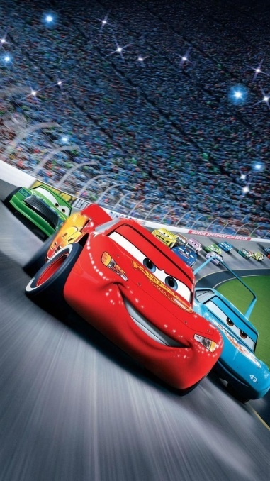

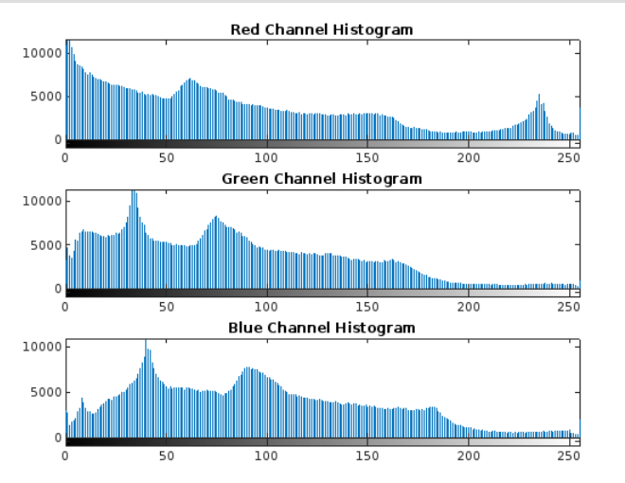
RESULTS
IMAGE 1
Original Image
Encrypted Image
Decrypted Image

Slide 18
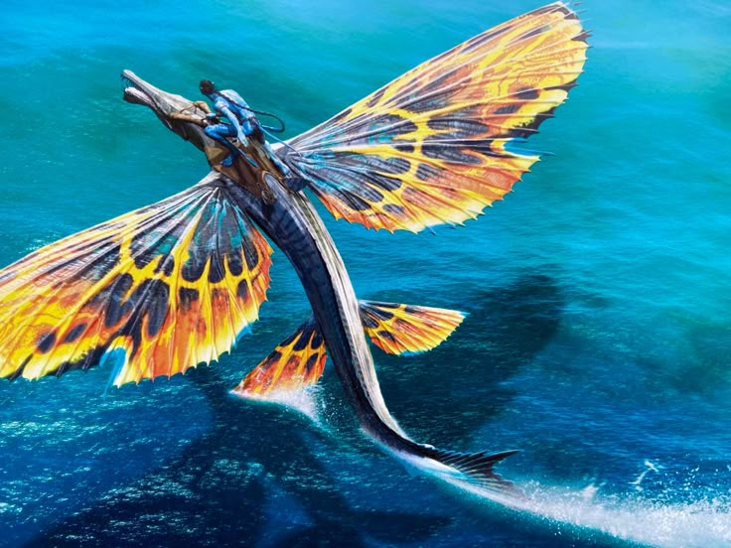

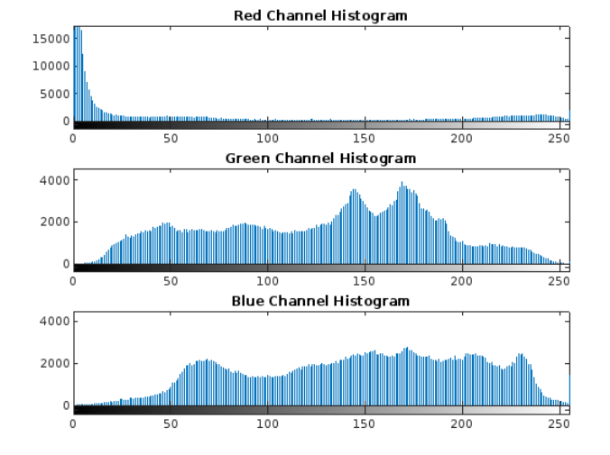
RESULTS
IMAGE 3
Original Image
Encrypted Image
Decrypted Image

Slide 19


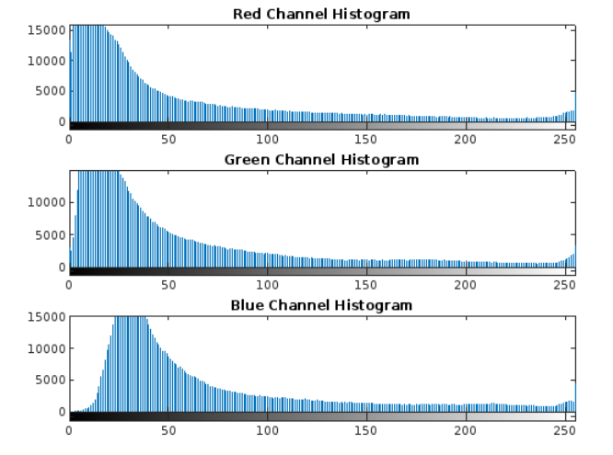
RESULTS
IMAGE 4
Original Image
Encrypted Image
Decrypted Image

Slide 20


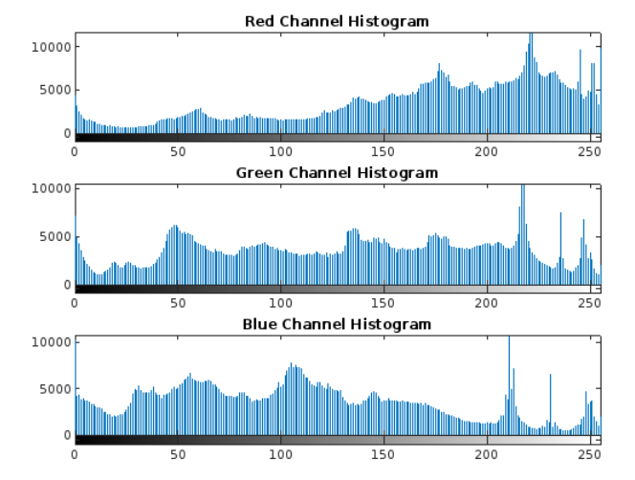
RESULTS
IMAGE 2
Original Image
Encrypted Image
Decrypted Image

Slide 21
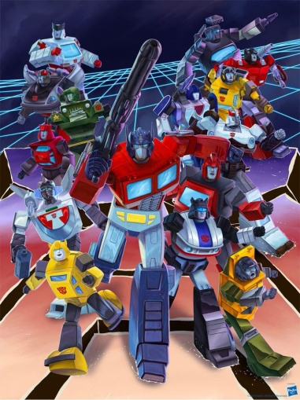
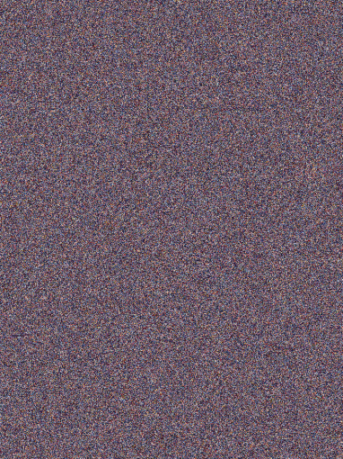
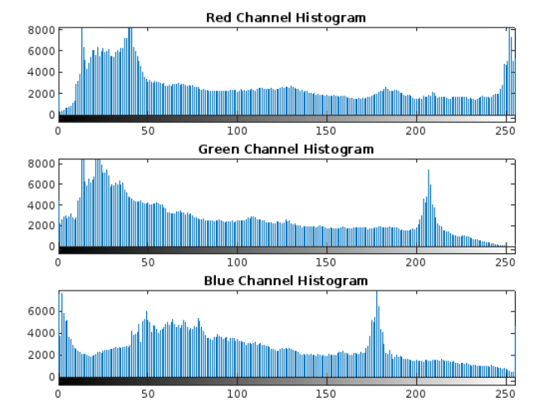
RESULTS
IMAGE 5
Original Image
Encrypted Image
Decrypted Image

Slide 22
PERFORMANCE ANALYSIS
Images | Channel | PSNR (dB) | SSIM | NPCR (%) | UACI (%) | MSE
 | Red | 8.3459 | 0.0095 | 99.4109 | 30.0639 | 9516.7645
Image 1 | Green | 10.2177 | 0.0156 | 99.4187 | 24.4816 | 6184.6273
 | Blue | 10.0171 | 0.0150 | 99.4808 | 25.2581 | 6476.9830
 | Red | 6.8862 | 0.0033 | 92.5419 | 30.2554 | 13318.5423
Image 2 | Green | 10.0420 | 0.0156 | 99.4962 | 25.4983 | 6439.8596
 | Blue | 9.9412 | 0.0164 | 99.5087 | 25.8477 | 6591.1674
 | Red | 9.1183 | 0.0101 | 98.8699 | 24.6110 | 7966.1265
Image 3 | Green | 9.2879 | 0.0112 | 99.0198 | 24.3713 | 7661.0117
 | Blue | 9.3150 | 0.0126 | 98.9742 | 24.4788 | 7613.4738
 | Red | 8.8569 | 0.0122 | 99.3911 | 28.1620 | 8460.4262
Image 4 | Green | 8.3117 | 0.0102 | 99.5092 | 31.2970 | 9592.0210
 | Blue | 8.8216 | 0.0113 | 99.4859 | 29.2412 | 8529.4379
 | Red | 7.3629 | 0.0084 | 99.4557 | 34.2769 | 11934.2117
Image 5 | Green | 8.4485 | 0.0101 | 99.4282 | 30.1024 | 9294.5117
 | Blue | 8.6263 | 0.0107 | 99.5110 | 29.8978 | 8921.8286
Table 1: Comparison of PSNR, SSIM, NPCR, UACI and MSE

Slide 23
PERFORMANCE ANALYSIS
Images | Channel | Entropy (Original) | Entropy (Processed)
 | Red | 7.6863 | 7.6863
Image 1 | Green | 7.6288 | 7.6288
 | Blue | 7.7230 | 7.7230
 | Red | 5.7931 | 5.7931
Image 2 | Green | 7.7314 | 7.7314
 | Blue | 7.7425 | 7.7425
 | Red | 7.0968 | 7.0968
Image 3 | Green | 7.2038 | 7.2038
 | Blue | 7.2116 | 7.2116
 | Red | 7.6751 | 7.6751
Image 4 | Green | 7.8682 | 7.8682
 | Blue | 7.7920 | 7.7920
 | Red | 7.7894 | 7.7894
Image 5 | Green | 7.7019 | 7.7019
 | Blue | 7.8196 | 7.8196
Table2: Comparison of Entropy

Slide 24
PERFORMANCE ANALYSIS
Images | Channel | Correlation Coefficient: Horizontal | Correlation Coefficient: Vertical | Correlation Coefficient: Diagonal
 | Red | 0.9778 | 0.9766 | 0.9602
Image 1 | Green | 0.9560 | 0.9514 | 0.9618
 | Blue | 0.9645 | 0.9500 | 0.9694
 | Red | 0.9731 | 0.9618 | 0.9734
Image 2 | Green | 0.9710 | 0.9493 | 0.9656
 | Blue | 0.9735 | 0.9508 | 0.9613
 | Red | 0.9595 | 0.9198 | 0.9864
Image 3 | Green | 0.9476 | 0.9178 | 0.9859
 | Blue | 0.9401 | 0.9196 | 0.9857
 | Red | 0.9632 | 0.9749 | 0.9594
Image 4 | Green | 0.9687 | 0.9773 | 0.9680
 | Blue | 0.9669 | 0.9755 | 0.9680
 | Red | 0.9497 | 0.9653 | 0.9402
Image 5 | Green | 0.9445 | 0.9532 | 0.9522
 | Blue | 0.9525 | 0.9521 | 0.9659
Table 3: Comparison of Correlation Coefficient (Horizontal, Vertical, Diagonal)

Slide 25
CONCLUSION
This design successfully developed a largely secure and effective color image encryption system by integrating Radial Base Function(RBF) scrambling, 2D Logistic Chaotic map, and DNA computing ways. This combination effectively crushed the typical failings of conventional image encryption styles, similar as inordinate pixel correlation, inadequate randomness, and vulnerability to cryptographic attacks. The perpetration of SHA- 256 mincing for crucial generation handed robust and largely changeable encryption keys, thereby enhancing the system's security. The confusion phase employed RBF grounded pixel rearrangement and non-adjacent pixel switching, while the prolixity phase employed chaotic sequences and DNA operations, performing in strong confusion and prolixity parcels that are vital for high- quality encryption. Statistical analyses, including entropy, NPCR, UACI, correlation portions, and PSNR values, verified the proposed system's effectiveness, robustness, and felicity for real- time operations.

Slide 26
FUTURE ENHANCEMENT
Although the proposed image encryption system achieves strong security, efficiency, and robustness, there are several areas where future improvements can be made.
One potential enhancement is the extension of the current method to support video encryption, enabling real-time protection for streaming applications such as surveillance and telemedicine.
Integration of deep learning models could also be explored for intelligent key management and for predicting optimal encryption parameters. Further, the system could be optimized to handle higher-resolution images (e.g., 4K or 8K) with minimal impact on encryption and decryption times.
Implementing parallel processing techniques using GPU acceleration could significantly speed up the encryption process, making it even more suitable for real-time applications. Lastly, testing the system under various attack models, such as chosen-plaintext and chosen-ciphertext attacks, can further strengthen its cryptographic robustness.

Slide 27
REFERENCES
Bilal, Muhammad, et al. "An efficient algorithm to generate dynamic substitution-boxes and its applications in image encryption." Alexandria Engineering Journal 116 (2025): 214-231.
Bencherqui, Ahmed, et al. "Optimal algorithm for color medical encryption and compression images based on DNA coding and a hyperchaotic system in the moments." Engineering Science and Technology, an International Journal 50 (2024): 101612.
Singh, Deep, et al. "Visually meaningful image encryption for secure and authenticated data transmission using chaotic maps." Journal of King Saud University-Computer and Information Sciences 36.10 (2024): 102235.
Hu, Junbao, et al. "Dynamically scattering medium-based security-enhanced optical image encryption using orbital angular momentum and deep learning." Results in Physics (2024): 108100.
Lu, Jun, et al. "A low-time-consumption image encryption combining 2D parametric Pascal matrix chaotic system and elementary operation." Journal of King Saud University-Computer and Information Sciences 36.8 (2024): 102169.
Nair, Aditi, Diti Dalal, and Ramchandra Mangrulkar. "Colour image encryption algorithm using rubik’s cube scrambling with bitmap shuffling and frame rotation." Cyber Security and Applications 2 (2024): 100030.
Inam, Saba, et al. "Security of End-to-End medical images encryption system using trained deep learning encryption and decryption network." Egyptian Informatics Journal 28 (2024): 100541.
Zhang, Zheyi, et al. "Chaotic color multi-image compression-encryption/LSB data type steganography scheme for NFT transaction security." Journal of King Saud University-Computer and Information Sciences 35.10 (2023): 101839.
Daoui, Achraf, et al. "Color stereo image encryption and local zero-watermarking schemes using octonion Hahn moments and modified Henon map." Journal of King Saud University-Computer and Information Sciences 34.10 (2022): 8927-8954.
Shakiba, Ali. "A randomized CPA-secure asymmetric-key chaotic color image encryption scheme based on the Chebyshev mappings and one-time pad." Journal of King Saud University-Computer and Information Sciences 33.5 (2021): 562-571.
Title

Slide 28
THANK YOU☺

